Slide 1


FIFA WORLDCUP ANALYSIS
By
Aniket Jamdade
(For a better experience watch it in the slideshow)
INTRODUCTION
FIFA, founded in 1904, has become the cornerstone of international football, uniting nations through the world's most beloved sport. From the inaugural World Cup in 1930 with just 13 teams, the tournament has expanded to include 32 teams by 2014, showcasing football's global reach. This presentation delves into the fascinating journey of FIFA, exploring its milestones, challenges, and the technological advancements shaping its future.

Slide 2
INTRODUCTION
FIFA WORLDCUP ANALYSIS
FIFA, founded in 1904, has become the cornerstone of international football, uniting nations through the world's most beloved sport. From the inaugural World Cup in 1930 with just 13 teams, the tournament has expanded to include 32 teams by 2014, showcasing football's global reach. This presentation delves into the fascinating journey of FIFA, exploring its milestones, challenges, and the technological advancements shaping its future.
By
Aniket Jamdade
Details Of the Data
1930
1950
2014

Slide 3
Details Of the Data
INTRODUCTION
1930
1950
2014
500K
Attendance
FIFA, founded in 1904, has become the cornerstone of international football, uniting nations through the world's most beloved sport. From the inaugural World Cup in 1930 with just 13 teams, the tournament has expanded to include 32 teams by 2014, showcasing football's global reach. This presentation delves into the fascinating journey of FIFA, exploring its milestones, challenges, and the technological advancements shaping its future.
Increased Teams and Participation from all over the World
3 Million Attendance
Main KPIs
Total Players Played - Players played throughout the Years
Total Matches Played - Total matches played throughout the years
Total Goals Scored – Goals Scored throughout the Years
Average Goals – Average Goals Per Match
Total Attendance – Total Attendance throughout the years

Slide 4
Details Of the Data
Main KPIs
1930
1950
2014
Total Players Played - Players played throughout the Years
Total Matches Played - Total matches played throughout the years
Total Goals Scored – Goals Scored throughout the Years
Average Goals – Average Goals Per Match
Total Attendance – Total Attendance throughout the years
INSIGHTS
Home Page
Total Attendance By Year: We can see the growth in interest in FIFA throughout the year. 1954 is the point where it starts trending up.
Total Teams Played By Year: This is also a good example showing more countries’ interest in a global sports event.
Total Players Played by Year: Same as more countries involvement this also gets affected.
Total Goals Scored By Players: Klose is the best player in FIFA having 17 goals in total.
Stadium Attendance: This shows the total attendance in the stadium till 2014

Slide 5
INSIGHTS
Main KPIs
Home Page
Total Attendance By Year: We can see the growth in interest in FIFA throughout the year. 1954 is the point where it starts trending up.
Total Teams Played By Year: This is also a good example showing more countries’ interest in a global sports event.
Total Players Played by Year: Same as more countries involvement this also gets affected.
Total Goals Scored By Players: Klose is the best player in FIFA having 17 goals in total.
Stadium Attendance: This shows the total attendance in the stadium till 2014
Total Players Played - Players played throughout the Years
Total Matches Played - Total matches played throughout the years
Total Goals Scored – Goals Scored throughout the Years
Average Goals – Average Goals Per Match
Total Attendance – Total Attendance throughout the years
Detail Page
All Matches Table: Here we can see the detailed table of all the teams going against each other in all the FIFA matches from 1930 to 2014. We can filter it by Home & Away teams and by year.
All Player Info: This table shows each Player’s info from the goals he scored to how many matches he played.
Total Goals Scored By Countries: Here we can see a ‘Packed Bubble Chart’ with each country and the total goals they scored. No wonder we imagine ‘Football’ when we hear Brazil.
Total Matches Played By Countries: Here we can judge based on the matches these countries played are aligned with the goals they scored.

Slide 6
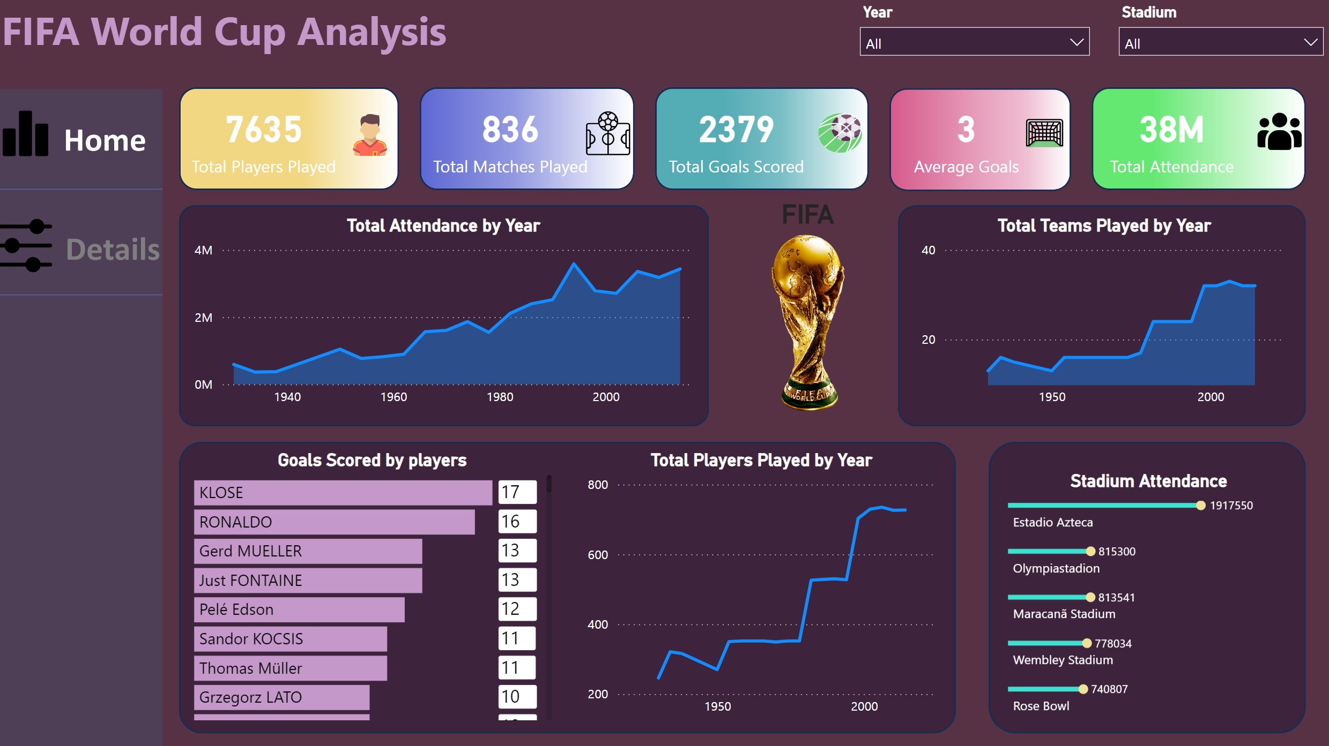
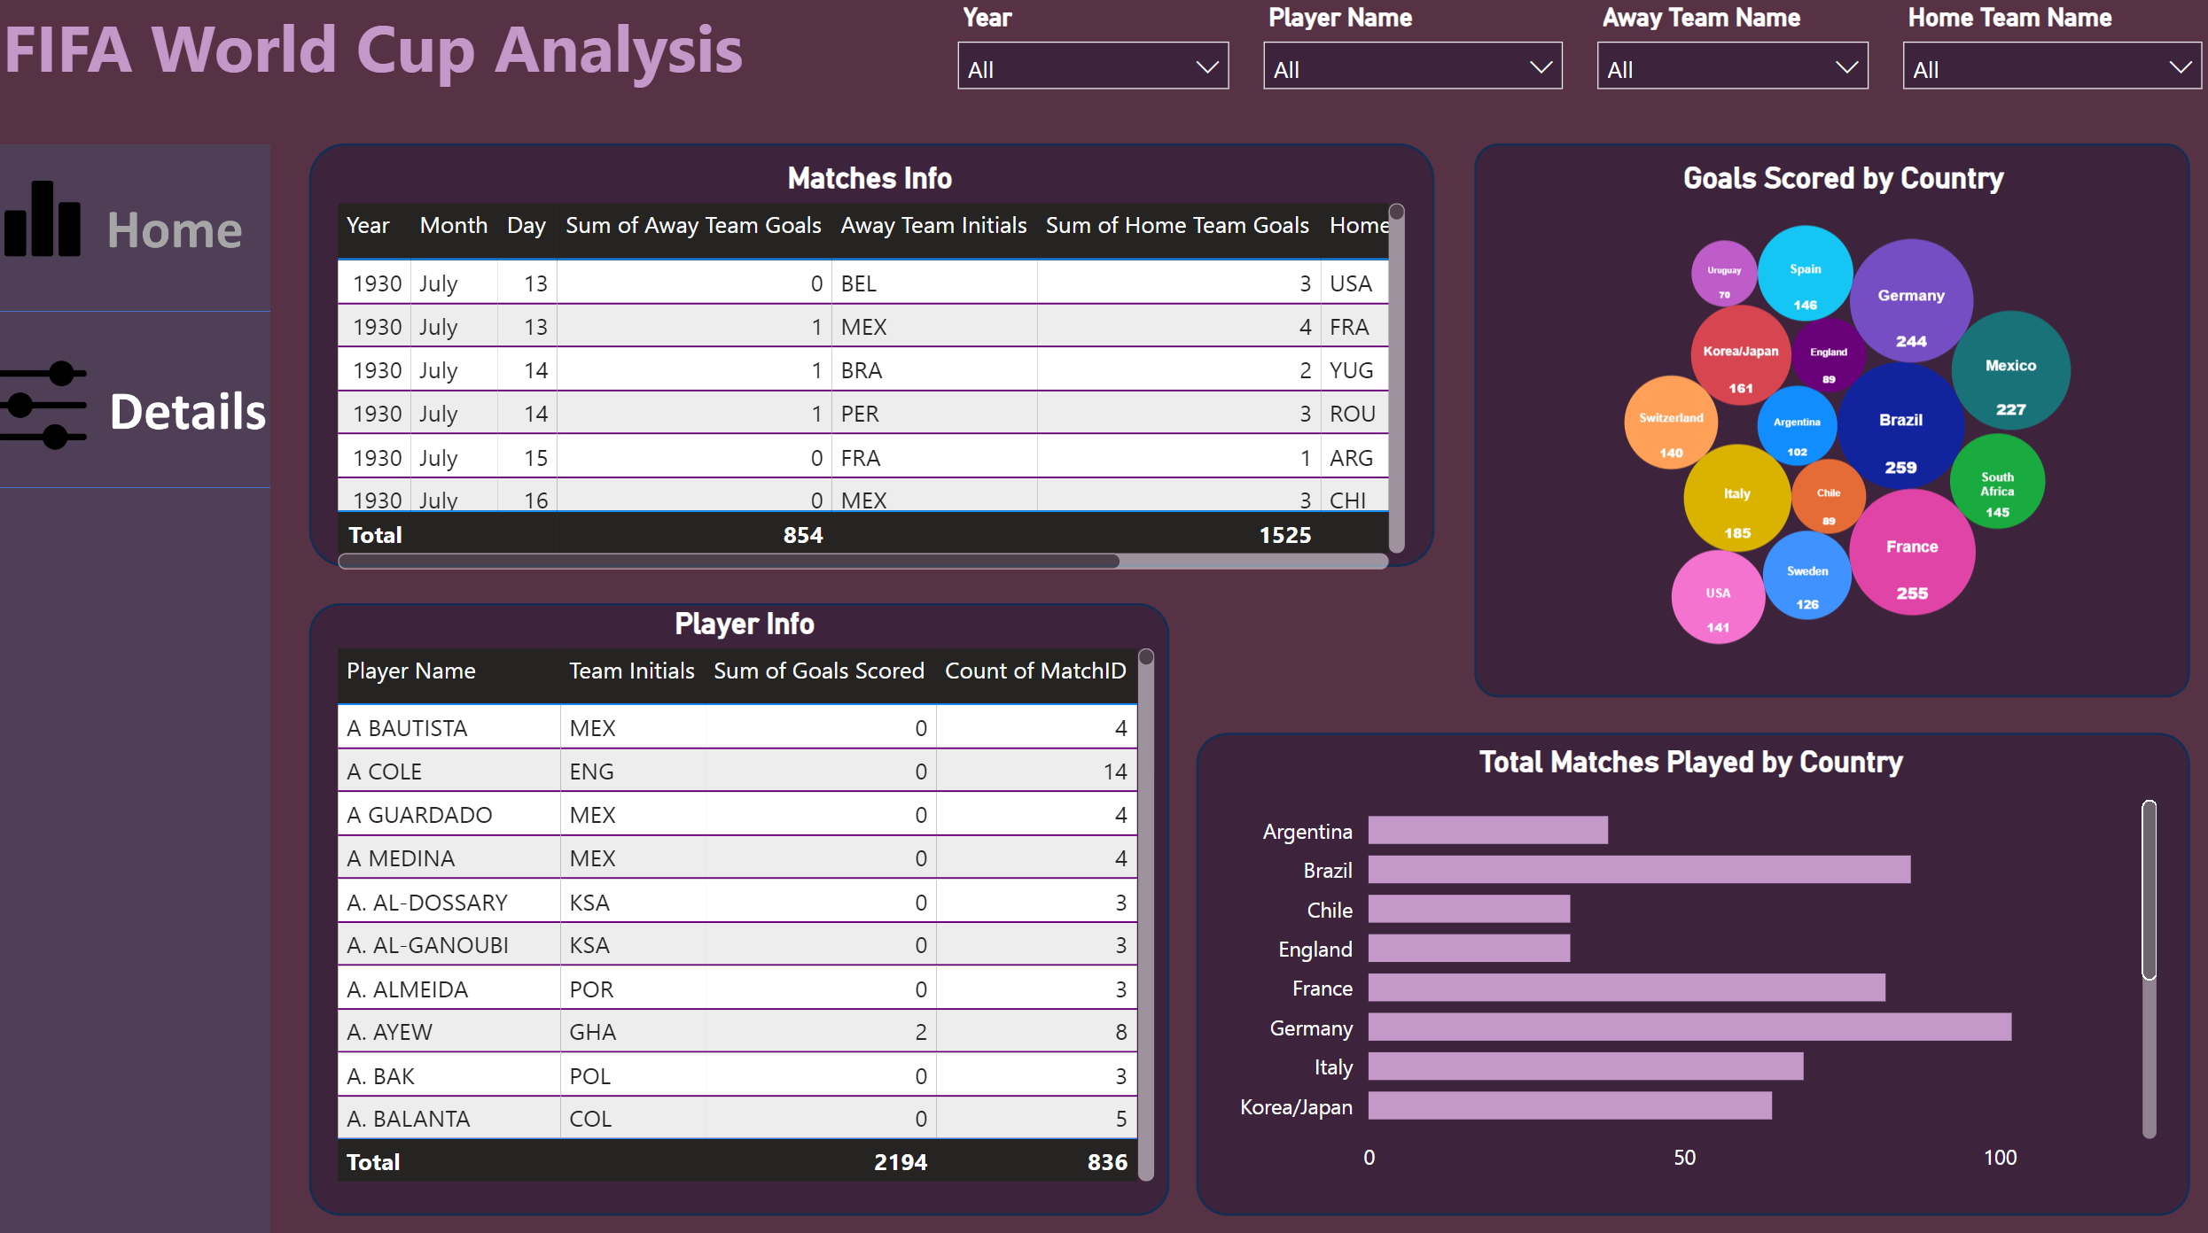
INSIGHTS
Detail Page
All Matches Table: Here we can see the detailed table of all the teams going against each other in all the FIFA matches from 1930 to 2014. We can filter it by Home & Away teams and by year.
All Player Info: This table shows each Player’s info from the goals he scored to how many matches he played.
Total Goals Scored By Countries: Here we can see a ‘Packed Bubble Chart’ with each country and the total goals they scored. No wonder we imagine ‘Football’ when we hear Brazil.
Total Matches Played By Countries: Here we can judge based on the matches these countries played are aligned with the goals they scored.
Home Page
Total Attendance By Year: We can see the growth in interest in FIFA throughout the year. 1954 is the point where it starts trending up.
Total Teams Played By Year: This is also a good example showing more countries’ interest in a global sports event.
Total Players Played by Year: Same as more countries involvement this also gets affected.
Total Goals Scored By Players: Klose is the best player in FIFA having 17 goals in total.
Stadium Attendance: This shows the total attendance in the stadium till 2014
My Design

Slide 7
INSIGHTS
My Design
Detail Page
All Matches Table: Here we can see the detailed table of all the teams going against each other in all the FIFA matches from 1930 to 2014. We can filter it by Home & Away teams and by year.
All Player Info: This table shows each Player’s info from the goals he scored to how many matches he played.
Total Goals Scored By Countries: Here we can see a ‘Packed Bubble Chart’ with each country and the total goals they scored. No wonder we imagine ‘Football’ when we hear Brazil.
Total Matches Played By Countries: Here we can judge based on the matches these countries played are aligned with the goals they scored.
LINK to the Report
THANK
YOU

Slide 8
My Design
THANK
YOU
LINK to the Report

